Slide 1
Fake News Detection Using Transfer Learning (English to Telugu)
Putta Tharun Sai
CED19I014
Dr. Sivaselvan B
Dept. of CSE, IIITDM Kancheepuram

Slide 2
Table of Contents
Introduction
Problem Definition
Literature Survey
Contribution /Work done
Code
Conclusion
Future Work
‹#›
Notes:
‹#›

Slide 3
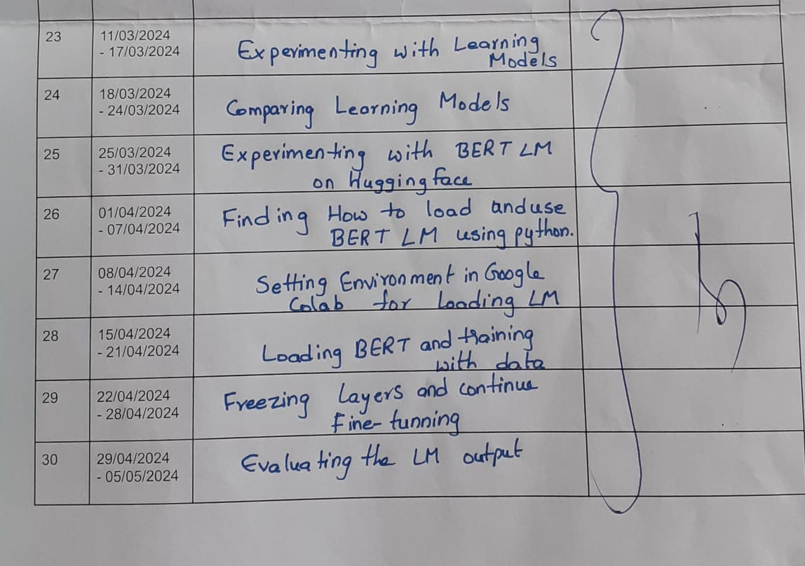
Weekly Review Report
‹#›
Notes:
‹#›

Slide 4
Reviews given by the panel members in the last evaluation meeting <Optional Slide> <Remove If not Applicable>
Those who are continuing on the extension of the design project as the final year project, need to write the reviews given by the panel members in the last evaluation meeting.
‹#›
Notes:
‹#›

Slide 5

Introduction
In the current digital world fake news has become a great problem making people unable to trust anybody. News organizations have also become untrustworthy by printing and spreading fake news.
Previously they used to say information is wealth but now it is hard to say whether what we know are heard is whether true or false.
‹#›
Notes:
‹#›

Slide 6
Problem Definition
The problem is to develop a machine learning model that can detect fake news from a dataset / databases.
The success of this project depends on the quality and quantity of the datasets that we use train the model.
The larger the training dataset the more accurate the model differentiates between real and fake news.
One other thing is also very important. That is for the application to be able to work without any big servers or hardware.
It should be simple for anyone to use.
‹#›
Notes:
‹#›

Slide 7
Literature Survey
These are the existing analysis and works related to fake news detection.
Using Machine Learning Algorithms : This helps in feature extraction and vectorization and then use sckit-learn and perform tokenization and feature extraction of text data. [1]
Using Social Network Analysis : In this clickbaits lure users into clicking on links with eye catching headlines or images. [2]
‹#›
Notes:
‹#›

Slide 8
Contributions/ Work Done
Transfer learning is an ML technique where pre-trained learning model in a task is adapted or fine-tuned for a related but different task.
Many solutions already exist in english language but there aren’t many good applications that deals with Telugu.
This approach is particularly useful when there is a limited amount of labeled data available for the target task, as it allows you to benefit from existing knowledge and data.
‹#›
Notes:
‹#›

Slide 9
We decided on using BERT(Bidirectional Encoder Representations from Transformers) as it provides several advantages.
BERT has already been trained in multiple languages including Telugu.
As it has been trained on large contextual data this helps it in recognising patterns and relationships between words in a sentence.
Due to its massive fine-tunning capabilities.
BERT achieves state-of-the-art results on many linguistic tasks, including text classification. Its ability to capture complex explanations makes it a popular choice for many NLP applications, including fake news detection.
‹#›
Notes:
‹#›

Slide 10
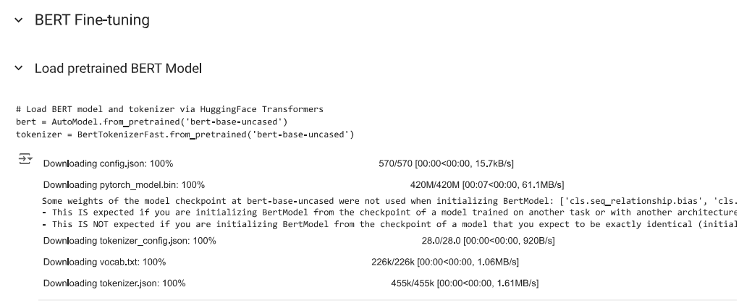
Codes
‹#›
Notes:
‹#›

Slide 11
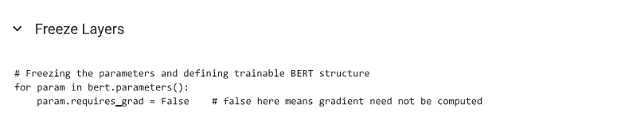
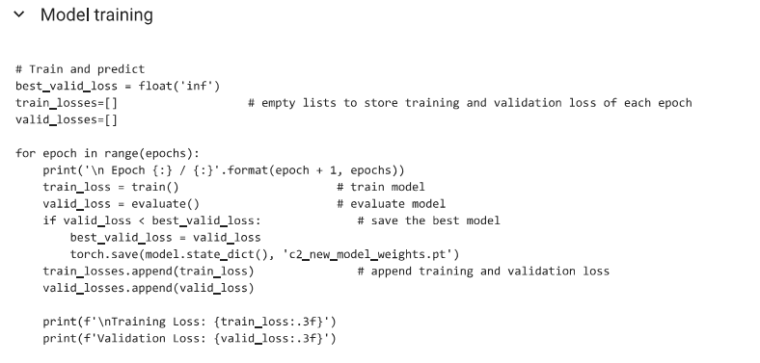

Slide 12
Conclusion
We wanted to build an application that can detect whether a given news is true or false with better accuracy and efficiency with minimal requirements. I hope we can continue this project and contribute to this important part of the future digital world.
‹#›
Notes:
‹#›

Slide 13
Future Work
The future scope for the project is to launch the application with good efficiency and correctness. If the results were quite good then I would like to explore other languages so that it can be used across the nation and even the world.
‹#›
Notes:
‹#›

Slide 14
References
[1] R. K. Kaliyar, A. Goswami, and P. Narang, “Fakebert: Fake news detection in social media with a bert-based deep learning approach,” Multimedia tools and applications, vol. 80, no. 8, pp. 11 765–11 788, 2021.
[2] A. Hosna, E. Merry, J. Gyalmo, Z. Alom, Z. Aung, and M. A. Azim, “Transfer learning: a friendly introduction,” Journal of Big Data, vol. 9, no. 1, p. 102, 2022
[3] L. Floridi and M. Chiriatti, “Gpt-3: Its nature, scope, limits, and consequences,” Minds and Machines, vol. 30, pp. 681–694, 2020.
‹#›
Notes:
‹#›

Slide 15
Thank You Any Questions?
‹#›
Notes:
‹#›

